Slide 1
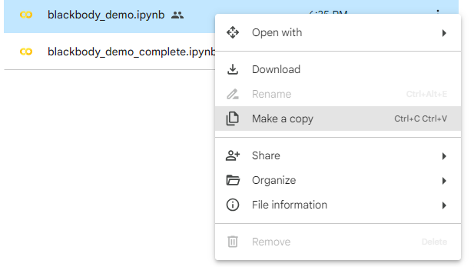
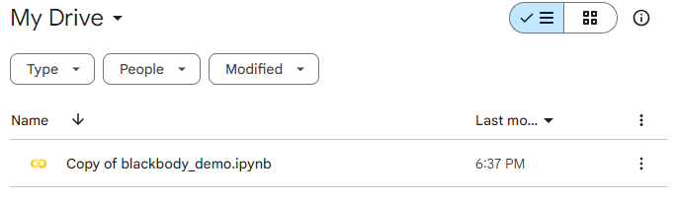
Pre-Workshop Instructions
Open the email you provided at sign-in and access Crash Course folder
Right click the “blackbody_demo.ipynb” file and “Make A Copy”
Return to your Google Drive “Home” and double-click on the “Copy of blackbody_demo.ipynb” file.
You’re now ready to code with us!

Slide 2


Python for STEM Crash Course
09/26/24
NASA, ESA, CSA, and J. Lee (NOIRLab), A. Pagan (STScI)
AN INTRODUCTION TO PYTHON FOR UNDERGRADUATES INTERESTED IN ASTRONOMY/SCIENTIFIC RESEARCH
By: IU Astronomy Graduate Students & Postdocs
(Brandon Radzom, Robert Howard, Kristin Baker, Lexi Gault,
Ethan White, Sarah Popp, Tash Sandford, Daniel Ornelas, Anika Goel, Agustin Heron, Dr. Caleb Choban)

Slide 3
Crash Course Purpose
Most astronomers, physicists, and other scientists use programming as a tool to understand/analyze data for research
Yet, most DO NOT receive any formal education on programming
This results in:
Barriers to enter research
Hard-to-read code
Non-reproducible science
Poorly optimized/slow code
Inefficient code dev. -> inefficient research

Slide 4
By the end of this Crash Course, you will…
Understand the core strengths of Python
Produce code on your own jupyter notebook on Google Colab
Understand the basics of:
Writing readable code
Print statements, variables, & lists
Logic & loops
Functions
Plotting
All while learning about black-body spectra!

Slide 5

with Python!

Slide 6
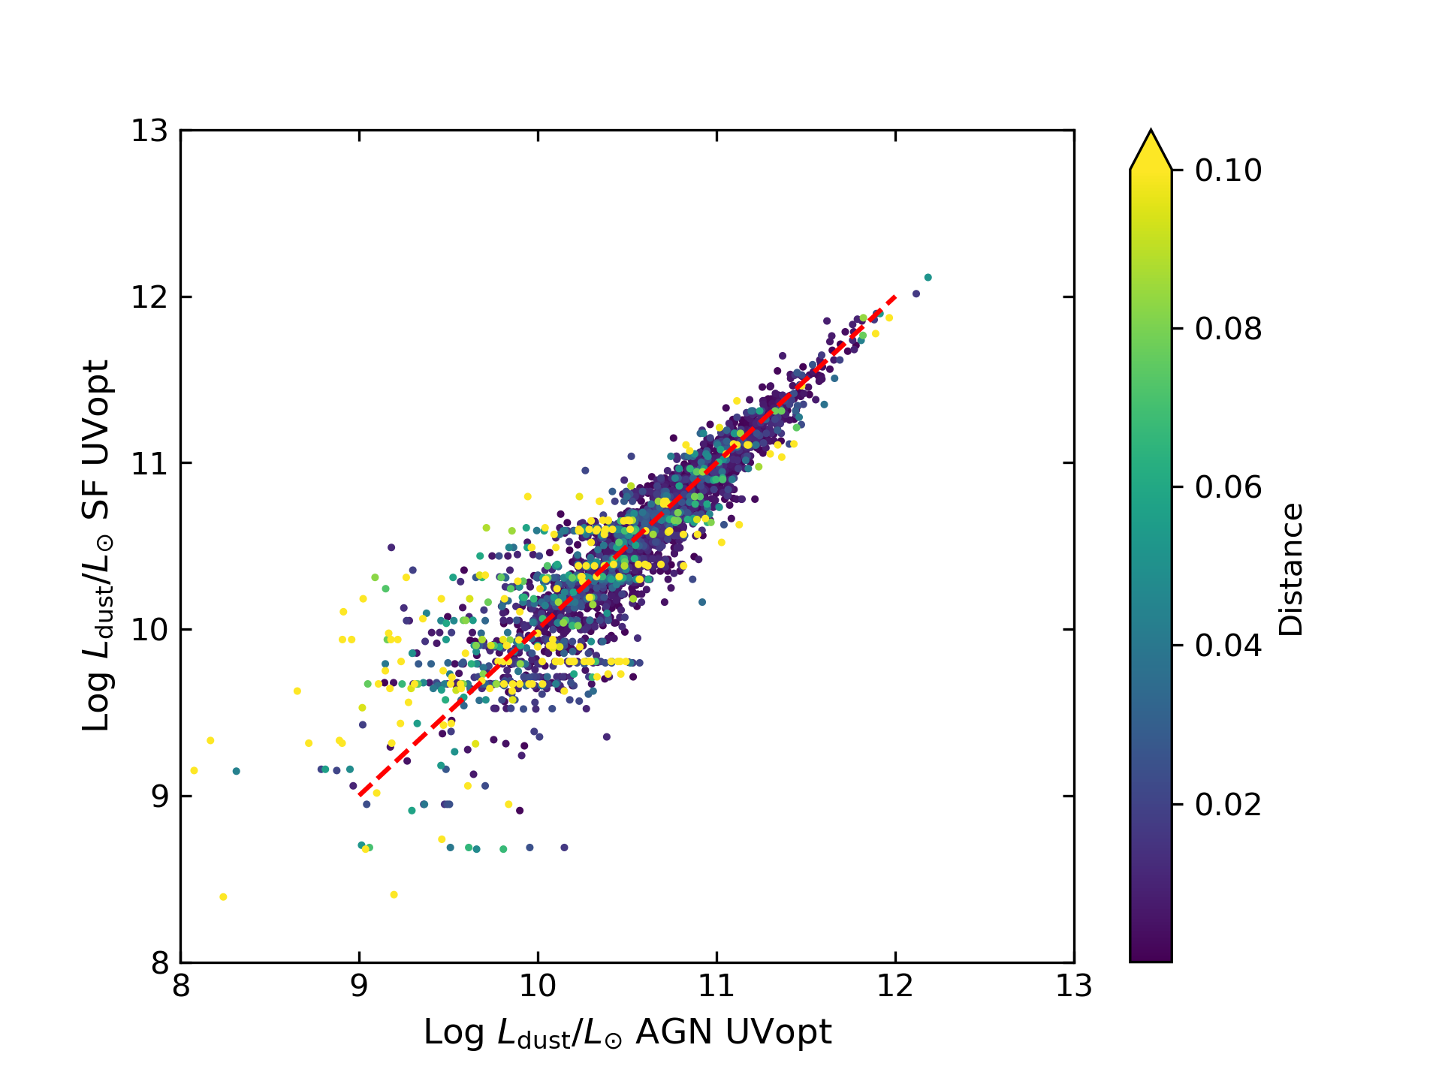
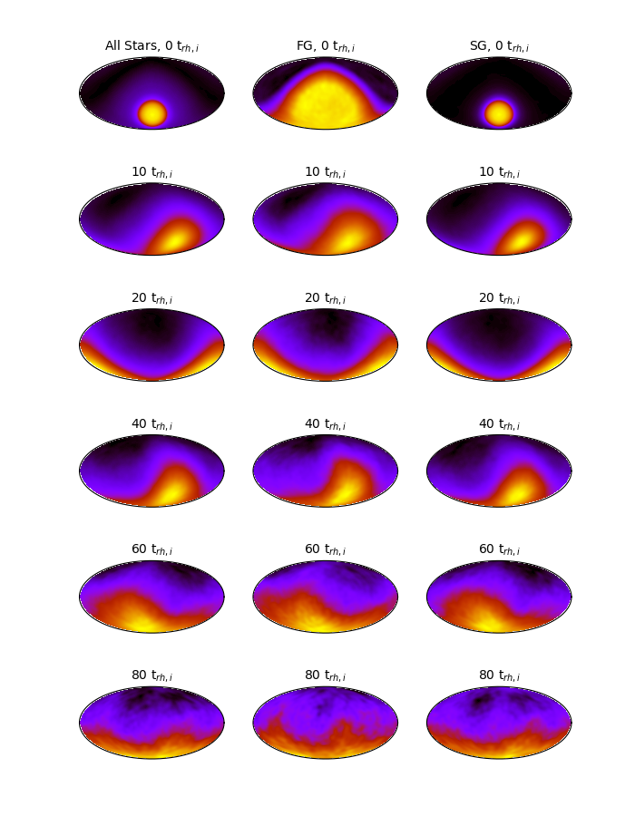
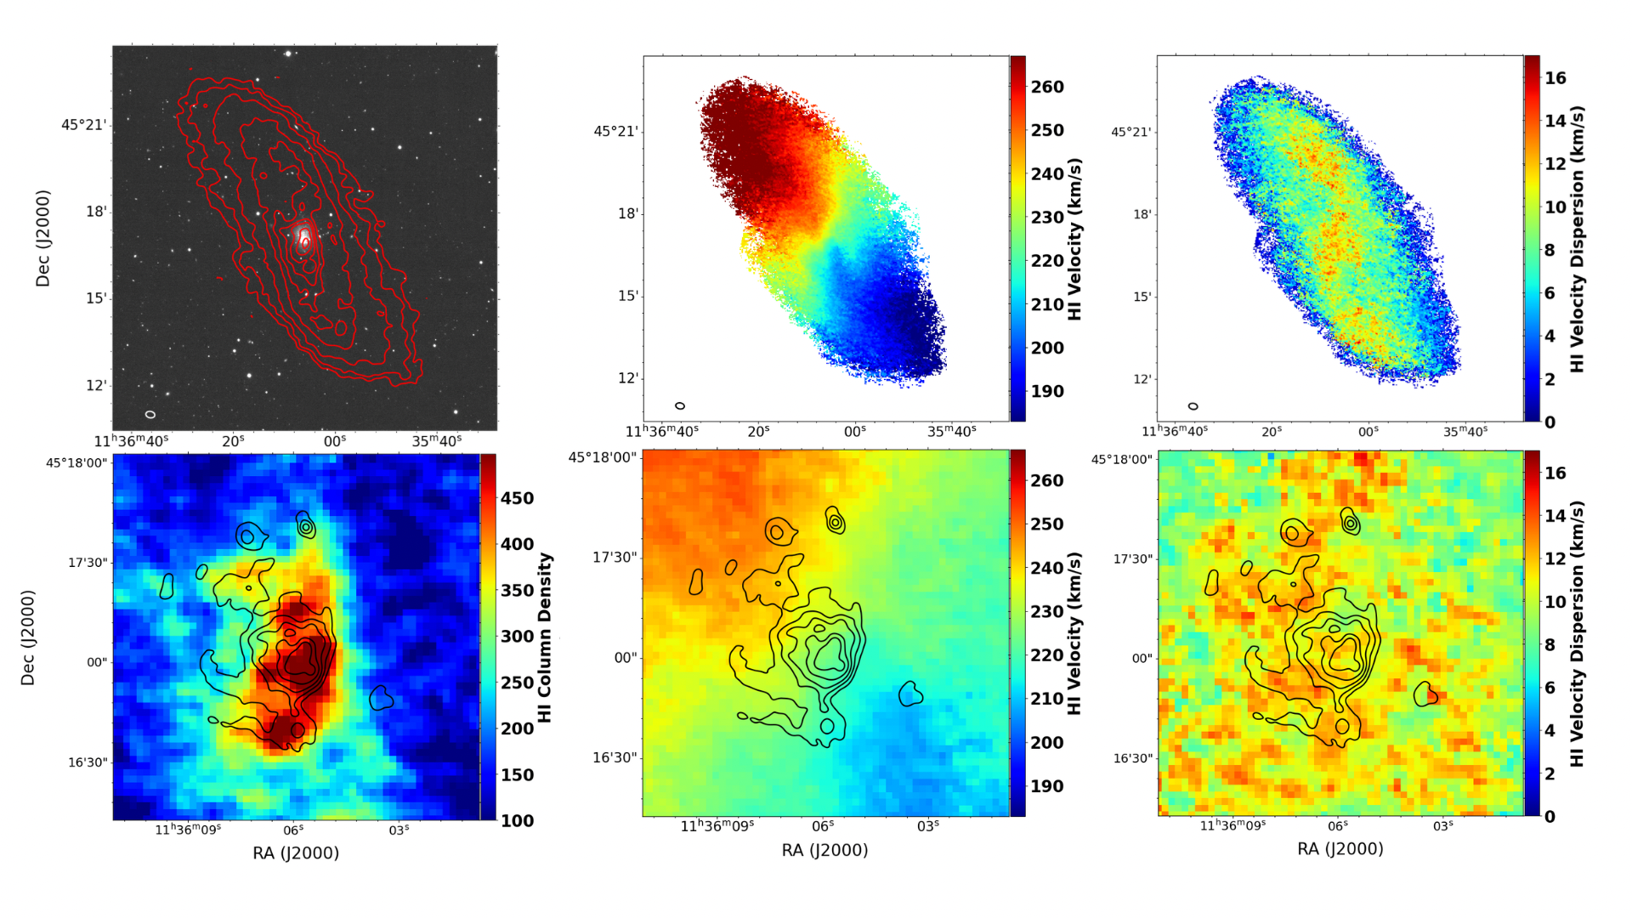
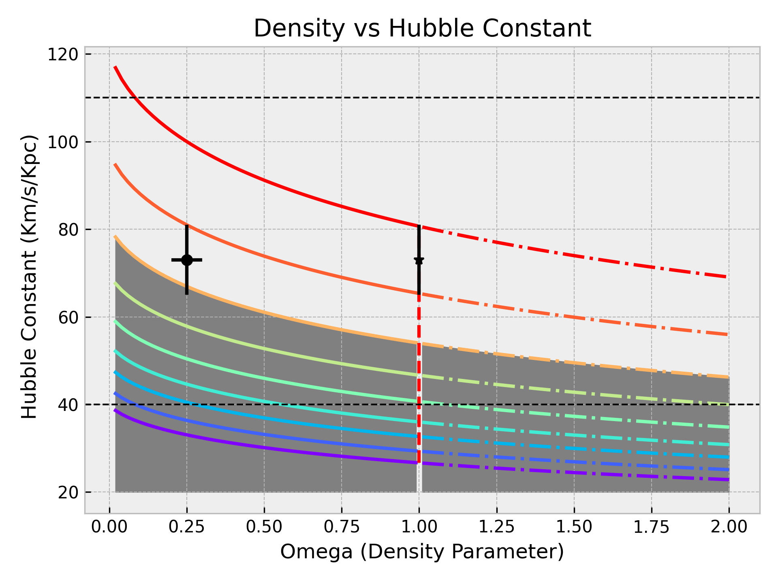

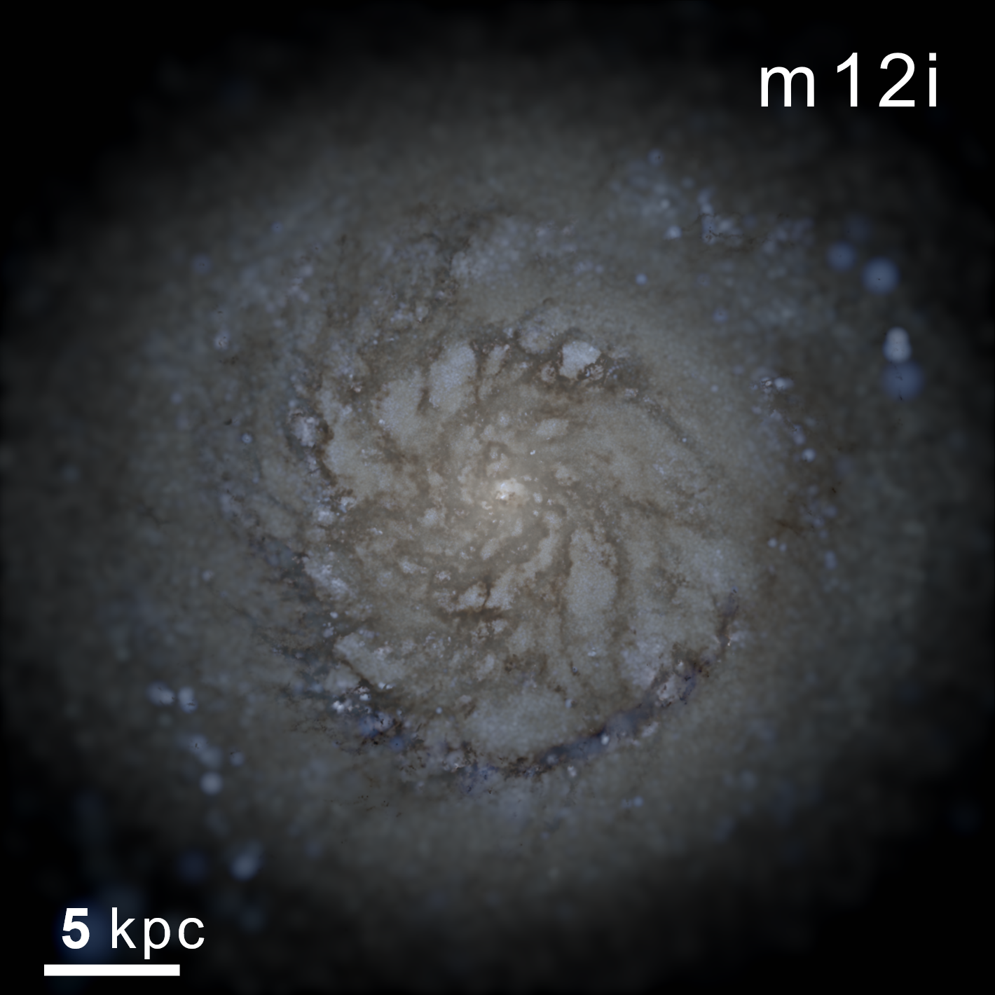
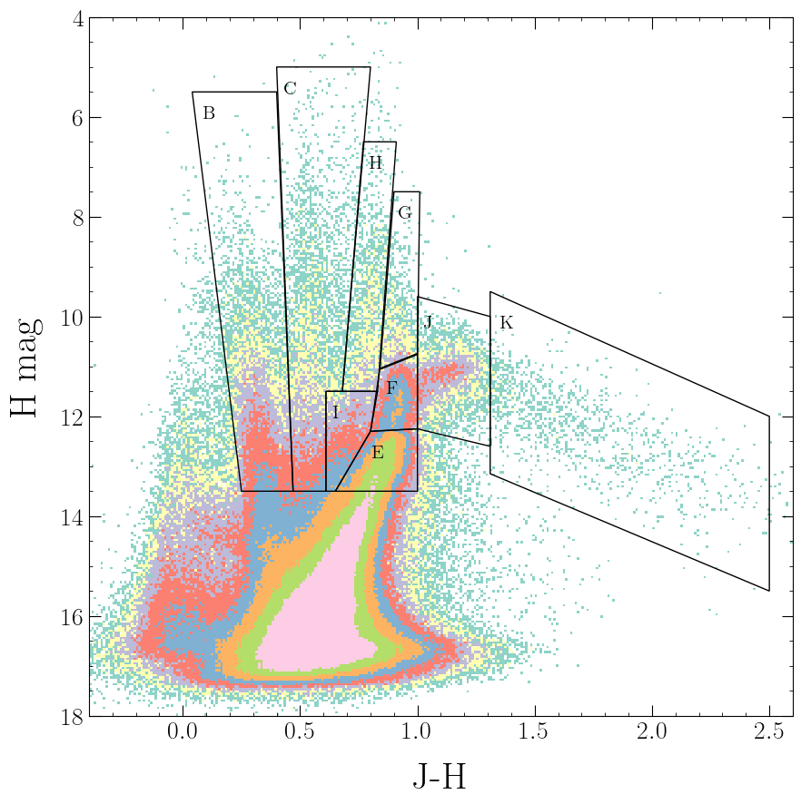
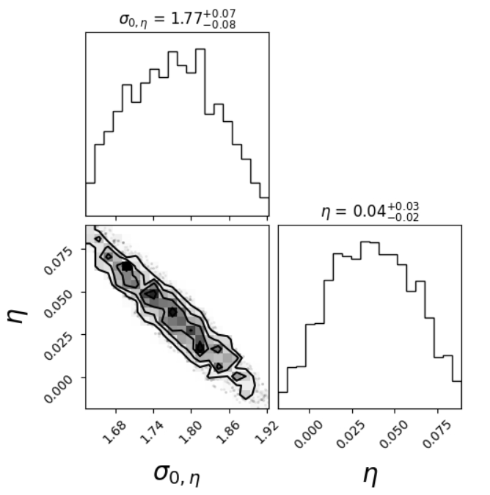
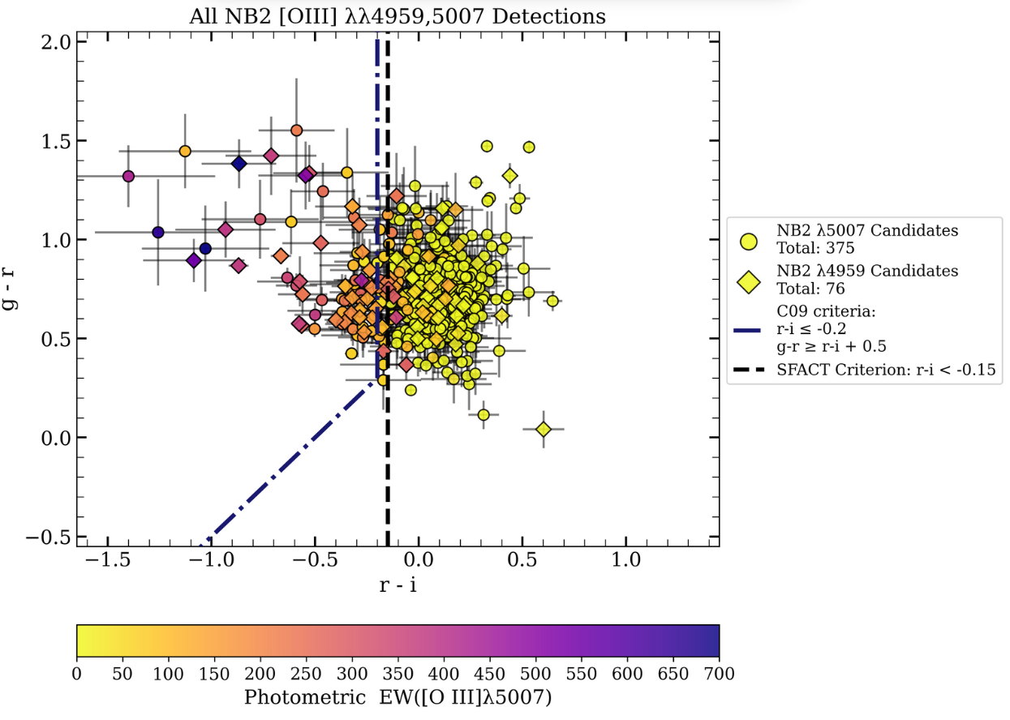
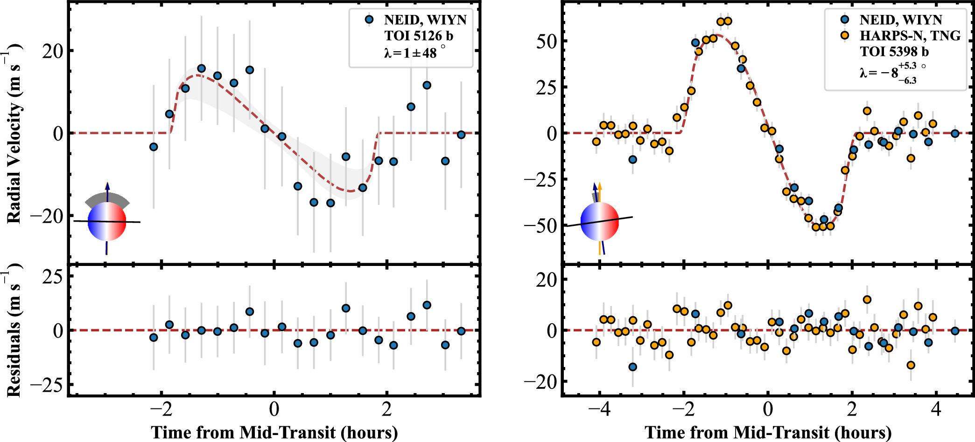
What we’ve done with Python!

Slide 7

Python
Documentation: https://docs.python.org/3/
Pros of Python:
Simple and user-friendly
Interpreted, high-level language
Cons:
A bit of a black box, slow
Interpreted, high-level language

Slide 8


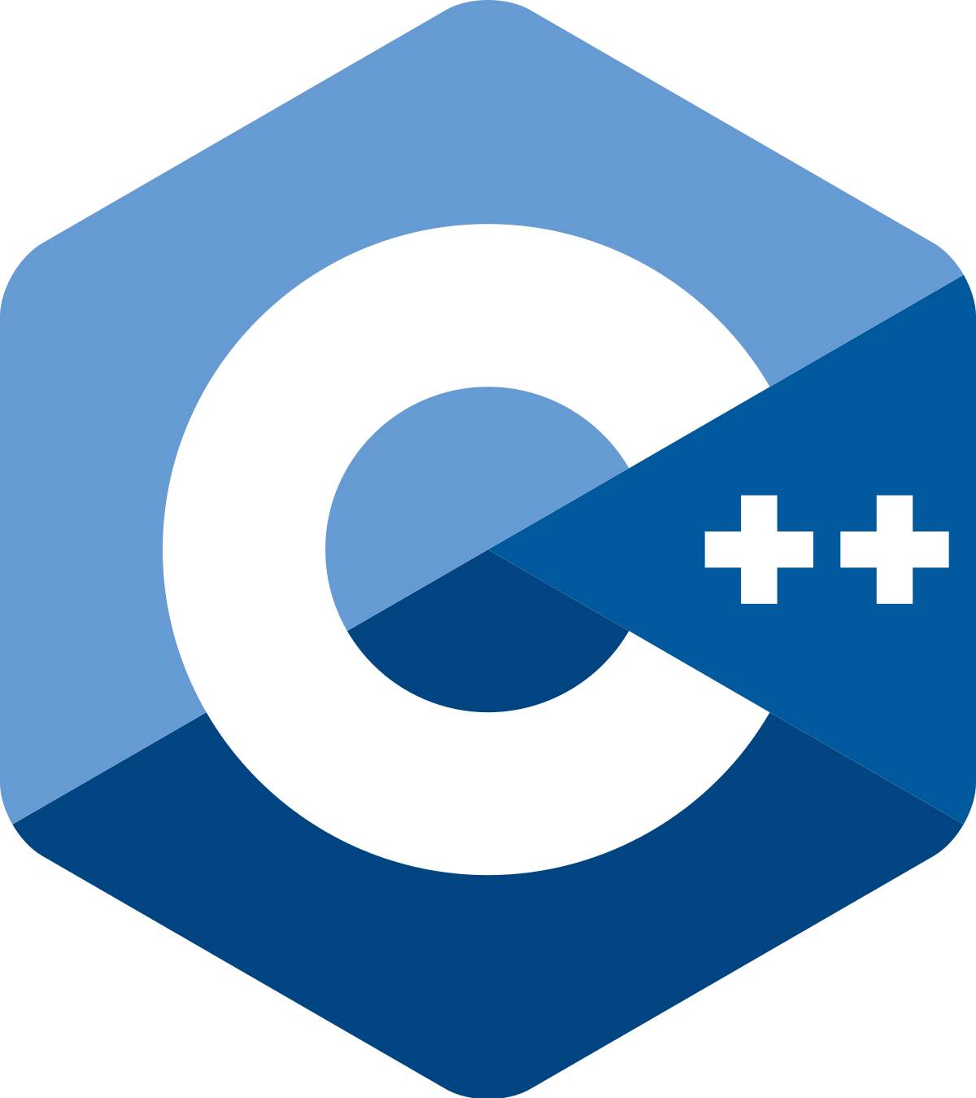


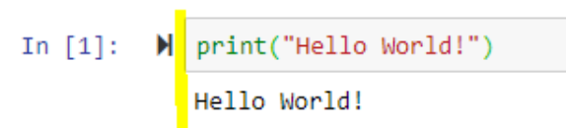
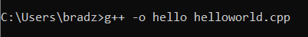
A Demonstrative Example: “Hello World”
C, C++,
Fortran, IDL
Python
#include <iostream>
int main() {
std::cout << "Hello World!";
return 0;
}

Slide 9








Where to write code in Python

Slide 10

Where to write code in Python

Slide 11
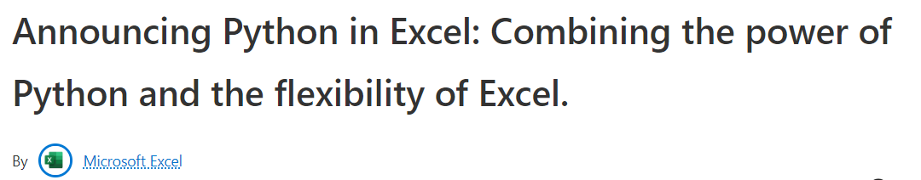
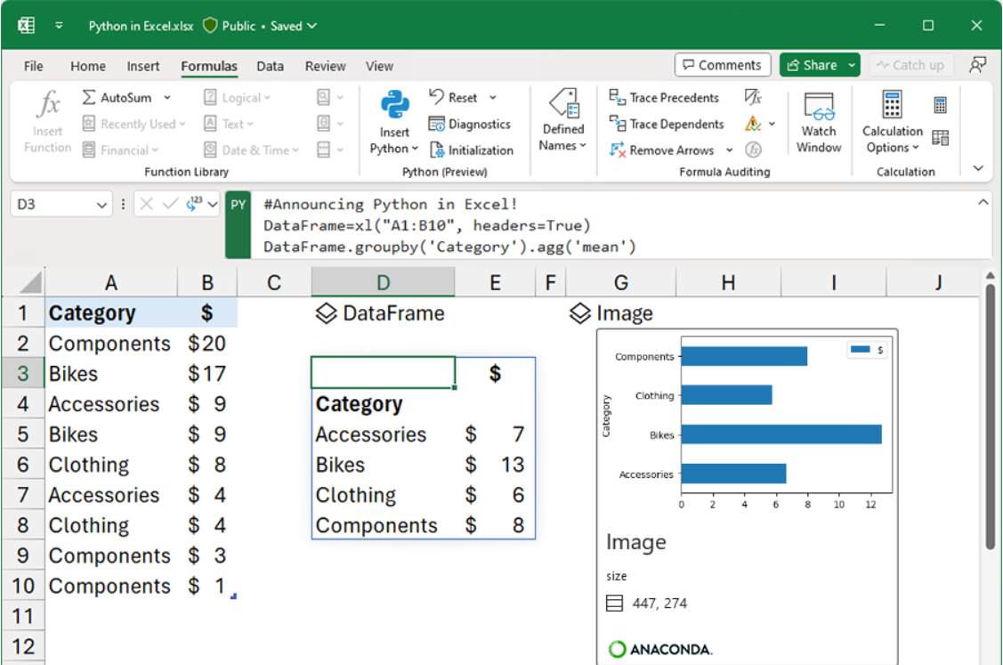
Where to write code in Python

Slide 12

Where to write code in Python

Slide 13




Where to write code in Python
IDEs: Integrated Development Environments
PyCharm
VSCode

Slide 14
What we’re using for the Crash Course
jupyter notebook: web-based interactive Python development tool
Cell-by-cell code blocks allow for:
Easy debugging & visualization
Quick and efficient code development

Slide 15
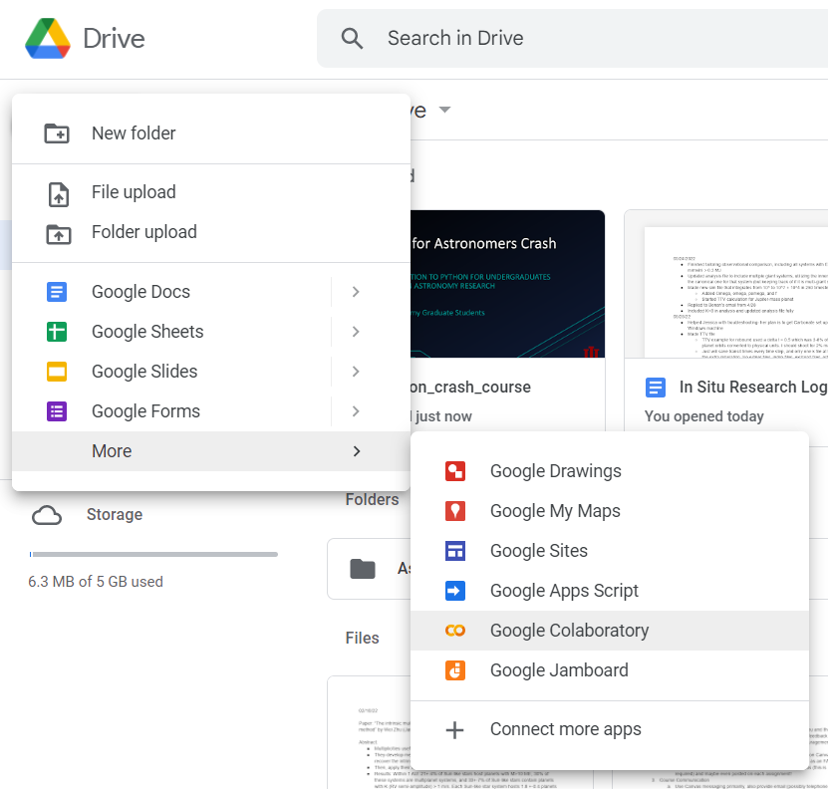

How we’re accessing jupyter: Google Colaboratory
https://colab.research.google.com/
Free web-based access to jupyter notebooks
Contains searchable practice examples and datasets
Allows collaboration (Google docs but for coding)

Slide 16

Let’s Code!

Slide 17

Advanced Python Workshop
Learn techniques that you can apply directly to your research/upper-level coursework
Casual, highly-interactive environment with experienced instructors
Potential topics:
Python installation/environments
Reading & writing files
Advanced plotting
Statistics
Numerical integration & simulations
Big data analysis & data fitting
YOU tell US!
Python .
Python .

Slide 18
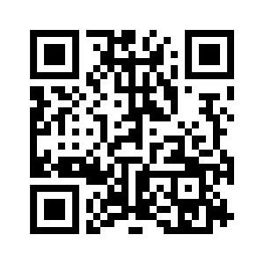
Please Fill Out Our F24 Advanced Workshop Interest Form!
Fall 2024 Advanced Workshop
When: October 22, 5:30-6:45 pm
Where: SW 208
Why: more Python & pizza
Full form link: https://forms.gle/CT7BGAqS4fFrTs8U6

Slide 19
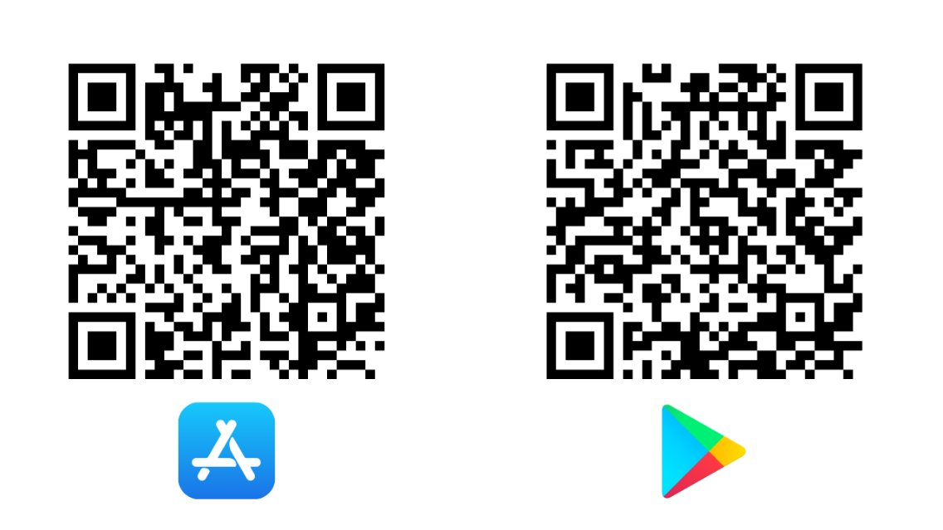

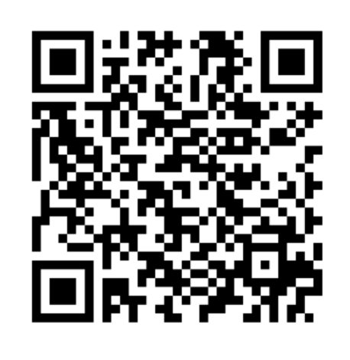
Create an account
Use Momentum to track your engagement on campus, find new opportunities, and develop the skills employers are looking for.​
Download the app and create your profile​
Find activities and earn points​
Level up in your career competencies
Get points for this event

Slide 20
BONUS SLIDES

Slide 21
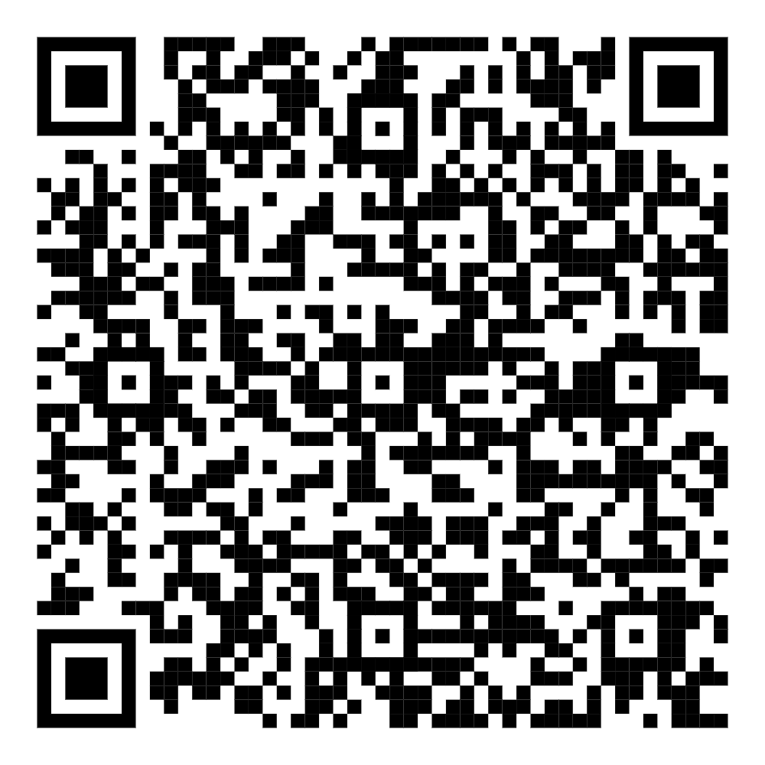
Let’s Code!
Scan QR to Google Drive Folder (must be logged into IU email)
Find blackbody_demo.ipynb and “Open With” Google Colab
OR
Download blackbody_demo.ipynb from our Google Drive Folder
Log onto Google Colab with IU account
“New” -> “File Upload”, then upload the .ipynb
Open the notebook!

Slide 22

Other Free Web-based Resources
Kaggle: https://www.kaggle.com/
Access Jupyter notebook
Python courses, lots of data science material
Practice datasets, online access to Jupyter, etc.

Slide 23

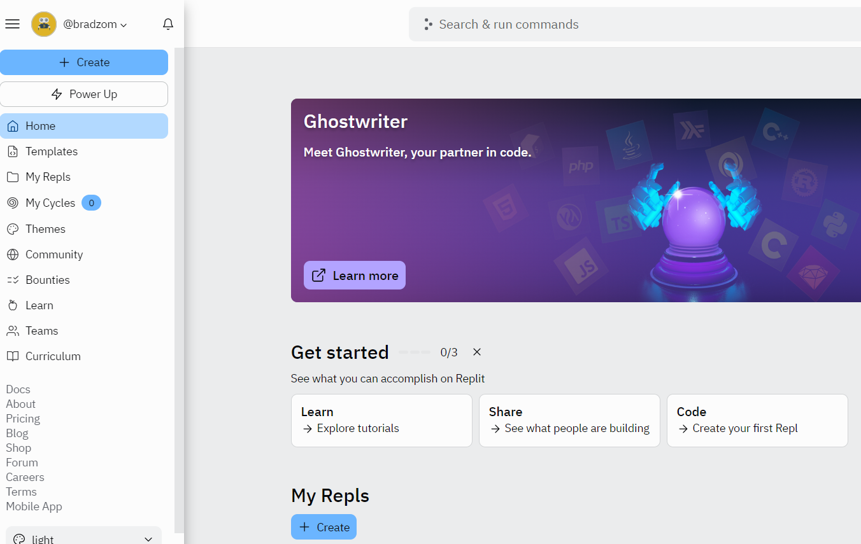
Other Free Web-based Resources
Replit: https://replit.com/
Must make account
Create scripts in Python, C++, Java, HTML, etc.
Collaborate with others using any language

Slide 24

Python & Anaconda/miniconda
Anaconda is a distribution platform for Python
The Conda environment handles issues & dependencies for you
Anaconda Navigator: graphical user interface for Conda
miniconda: lightweight version of anaconda, good if you have multiple environments

Slide 25
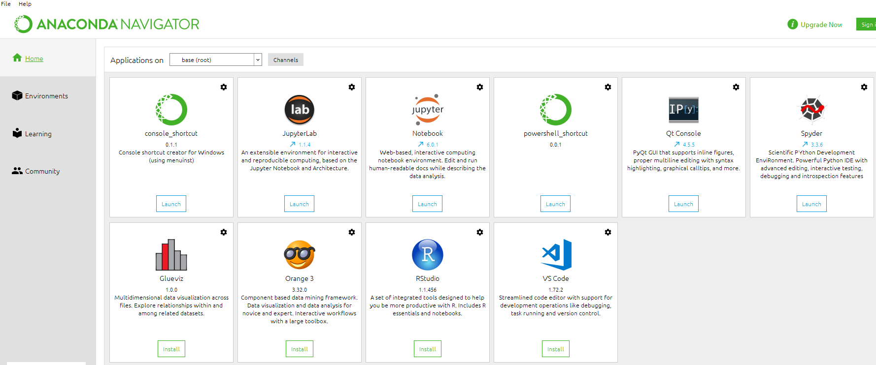
Anaconda Installation (personal computer)
Go to: https://www.anaconda.com/products/distribution
View from “Navigator” should look like:

Slide 26
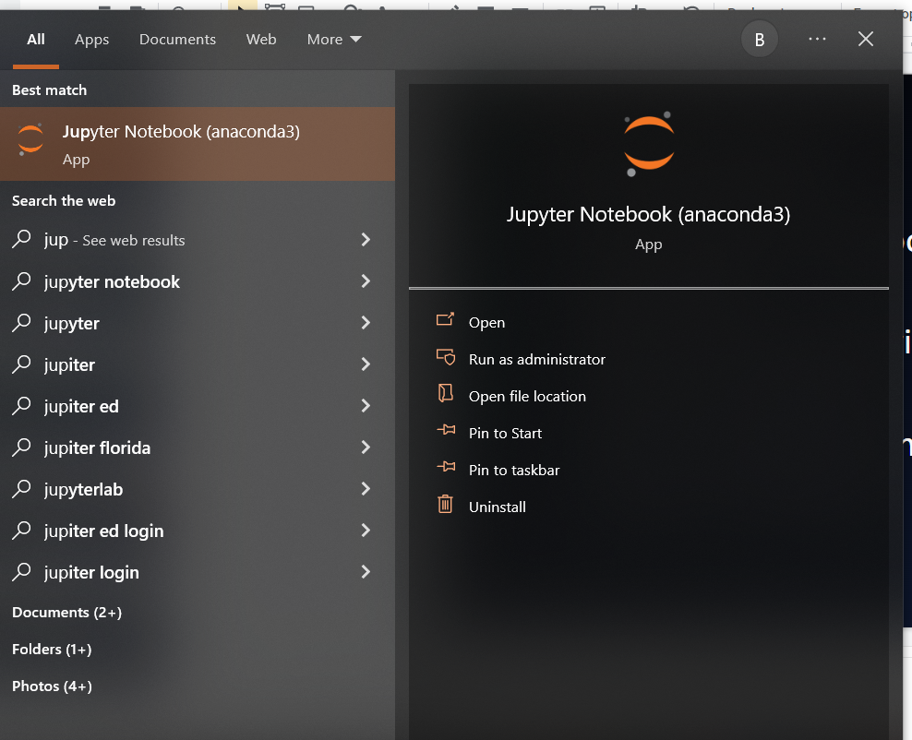
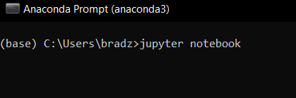
Running Jupyter
Personal computer:
Open the “Anaconda Navigator” -> click “Launch” under Jupyter logo
Type “Jupyter notebook” in your local search bar
Open the “Anaconda Prompt” -> enter “jupyter notebook”

Slide 27
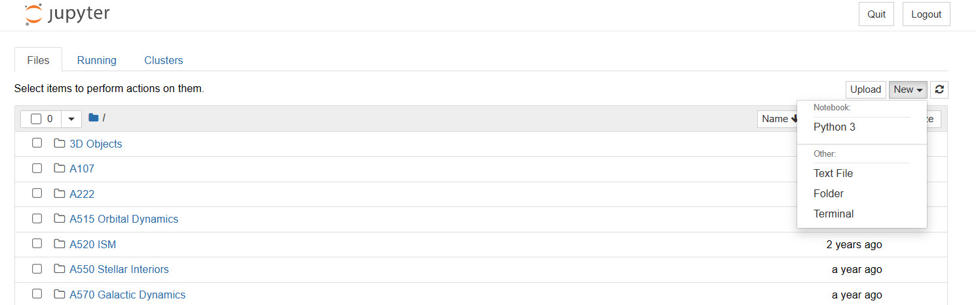
Start a Jupyter notebook
“New” -> “Python 3”
Write your code!

Slide 28

Super serious about research? Check out IU’s supercomputers!
Big Red 200
8,000,000,000,000,000 operations/sec
Quartz
Carbonate (retired in Dec 2023)
Emily Sterneman, Indiana University

Slide 29
IU’s Research Desktop (RED)
Graphical desktop service for Carbonate users
Unix-like system
Access to 8-12 cores, 80 GB of memory
As an IU student, you can access Python on RED
First request Carbonate and Slate computing accounts
Then access RED via Thin Linc
Finally, load in Anaconda & start Python!

Slide 30
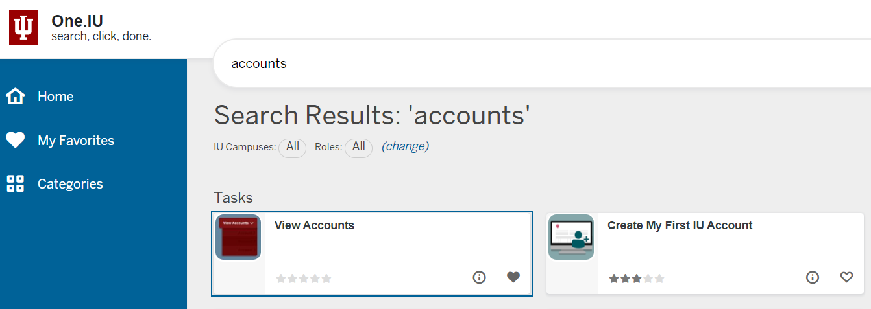
Step 1: Check one.iu.edu for accounts

Slide 31
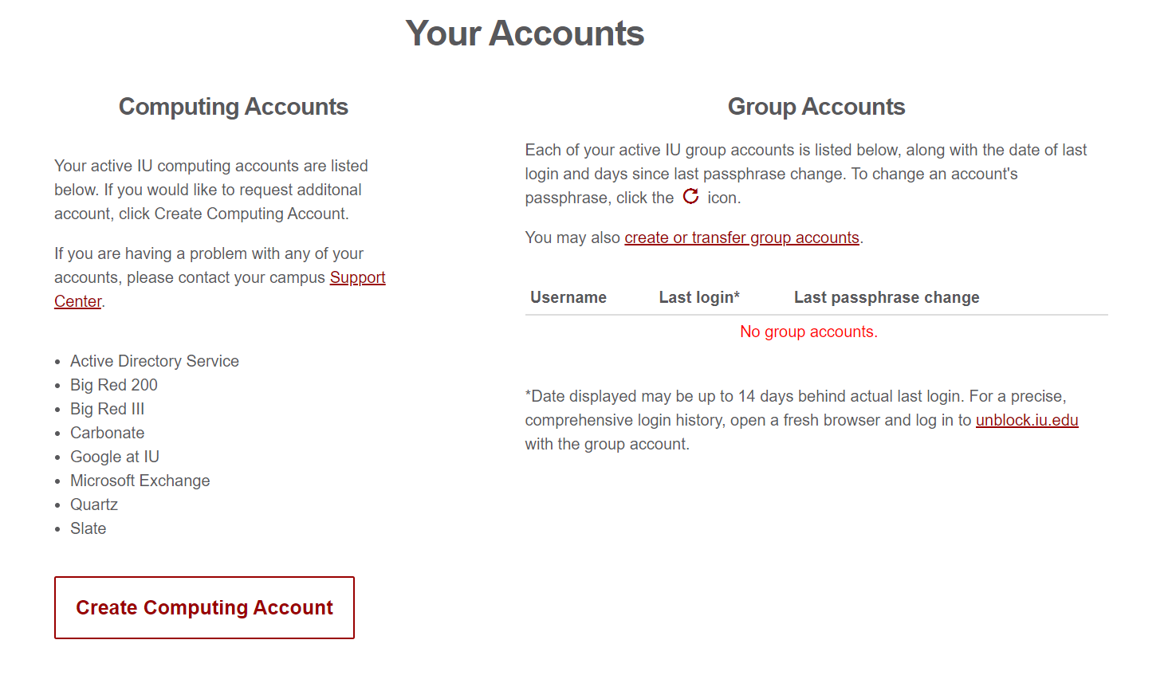
Step 2: Create Computing Account

Slide 32
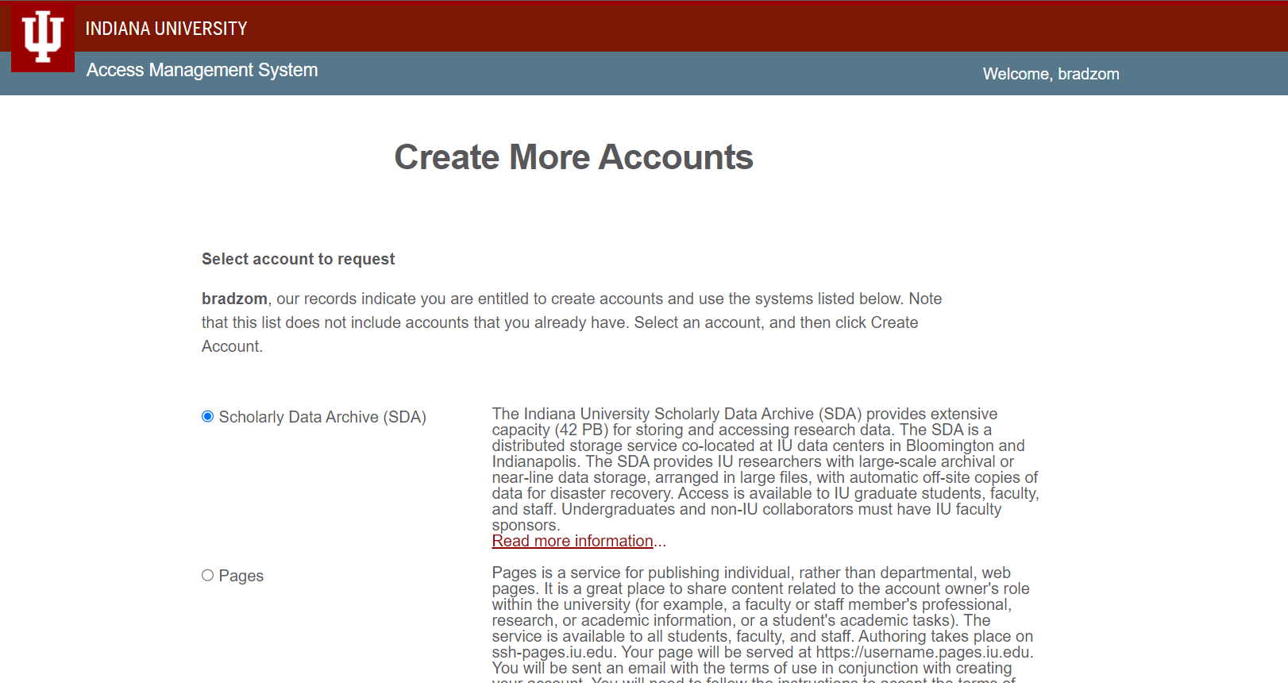

Slide 33
Step 3: Request Carbonate/Slate Computing Accounts
Select “Quartz” and “Slate”
Quartz = computer cluster
Slate = storage
~20 min for account creation
Knowledgebase page for help:
First account? https://kb.iu.edu/d/achn
Additional account? https://kb.iu.edu/d/achr

Slide 34
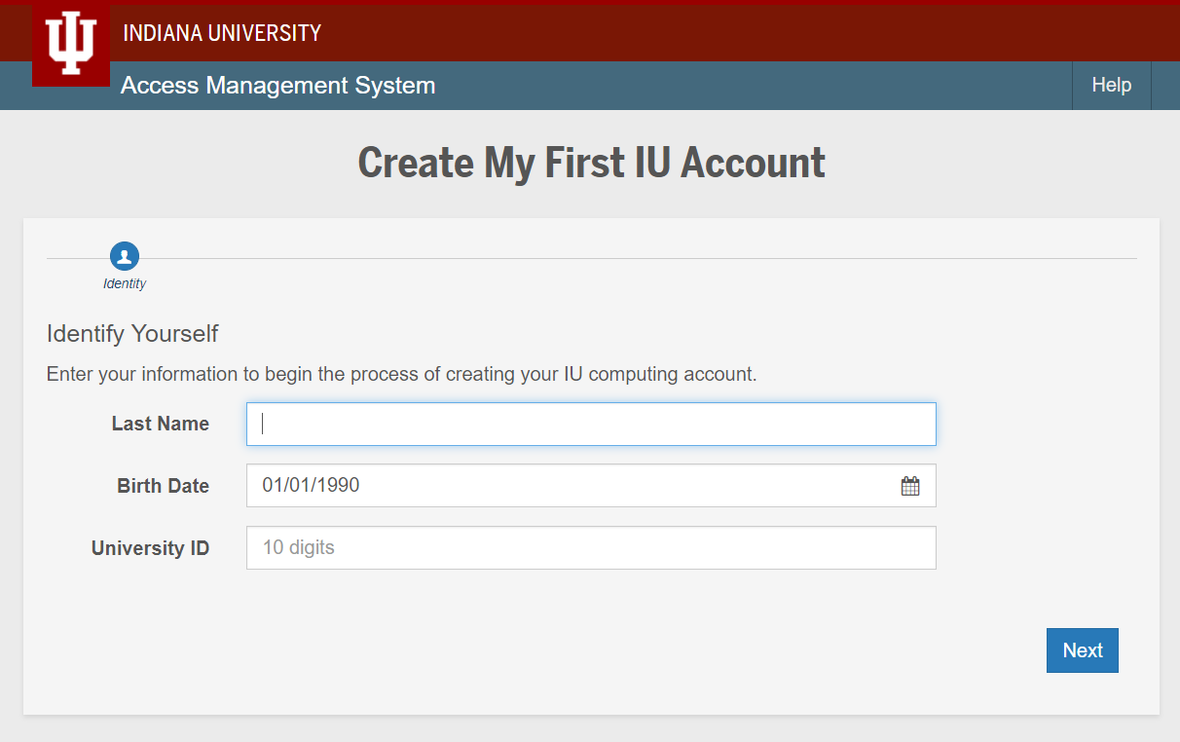

Slide 35

Step 4: Accessing RED/Carbonate with ThinLinc
Login at https://red.uits.iu.edu/
If you want to install ThinLinc client onto your personal machine, follow the directions at https://kb.iu.edu/d/aput
Follow ALL instructions through “Public key authentication” (this part is unnecessary and tricky)

Slide 36
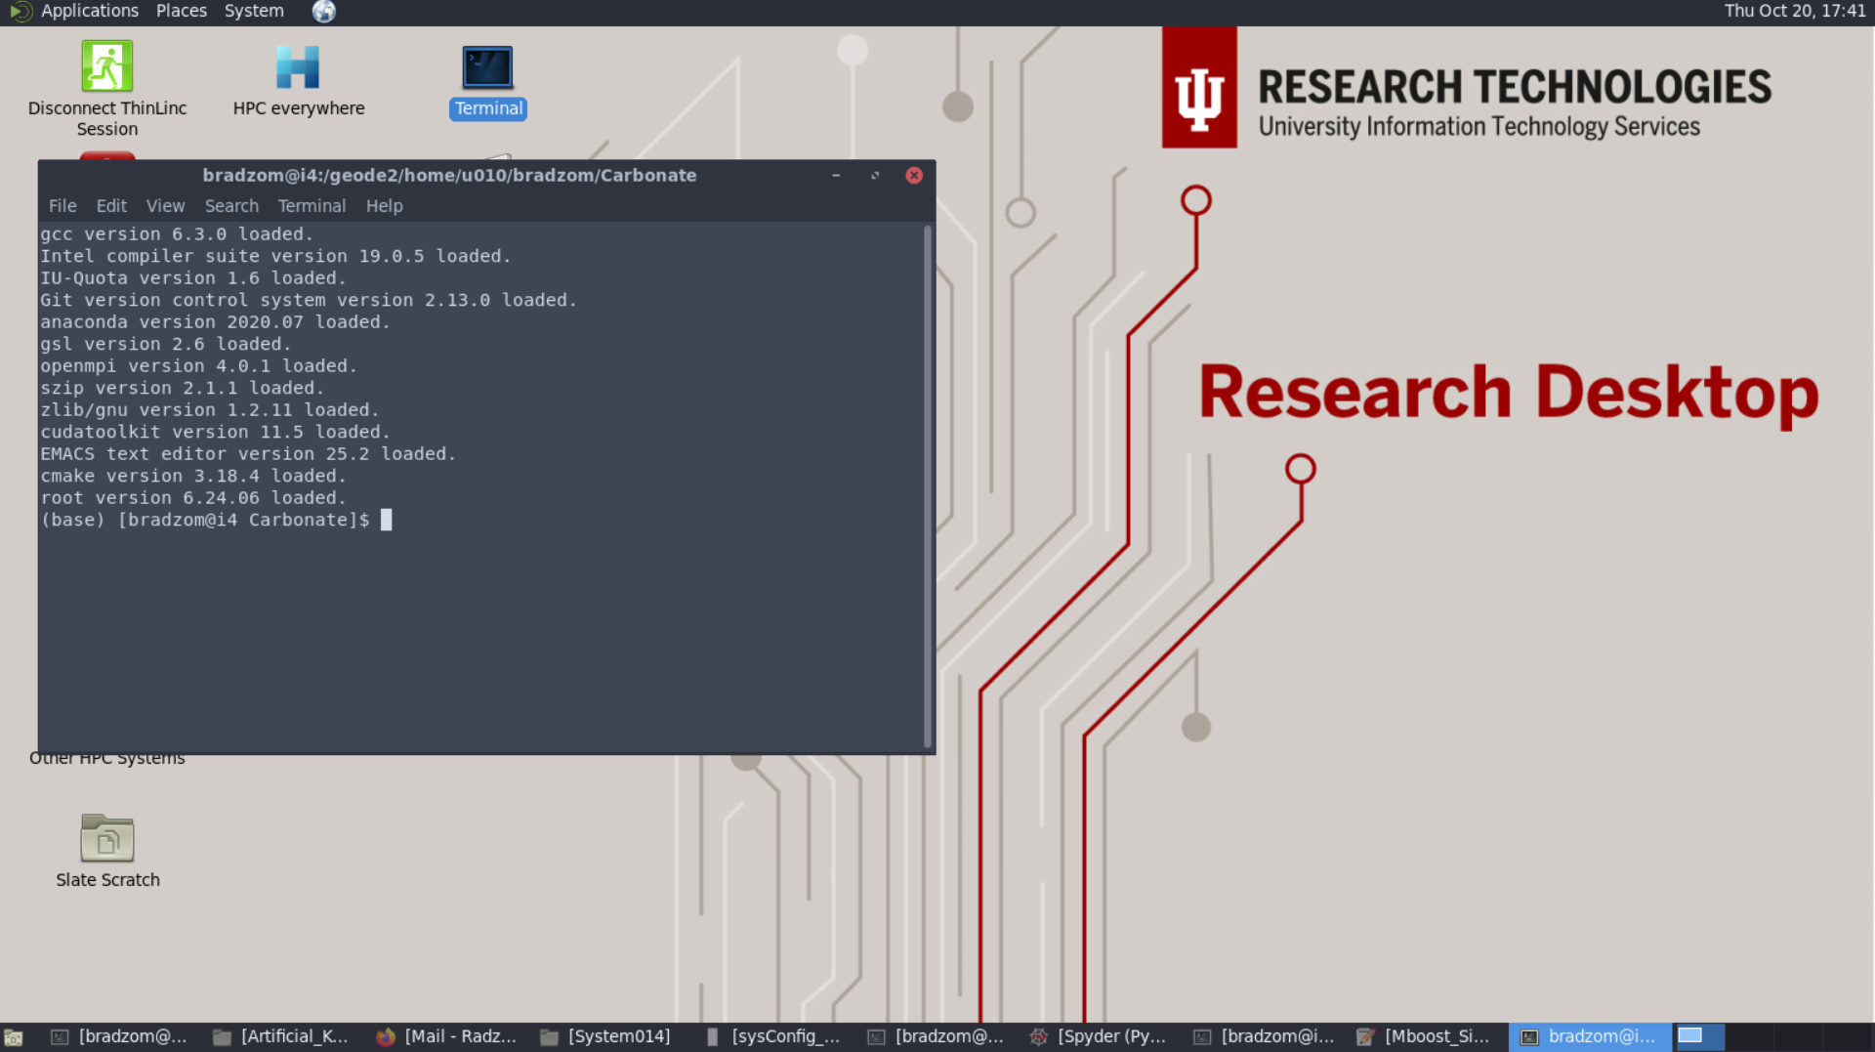

Slide 37
Step 5: Setting up Python/anaconda on RED
Open the Terminal
Type “module unload python”, enter
Type “module load anaconda”, enter
*Note these 3 steps need to be repeated every time you log back in unless you add these commands to your .modules file in your home directory on Carbonate

Slide 38
Step 6 (final): Run Python on RED
Open Terminal -> enter “jupyter notebook”
Start your notebook and begin coding!
Note: When logged on to RED, any code you run is already automatically using the Carbonate computer cluster

Slide 39
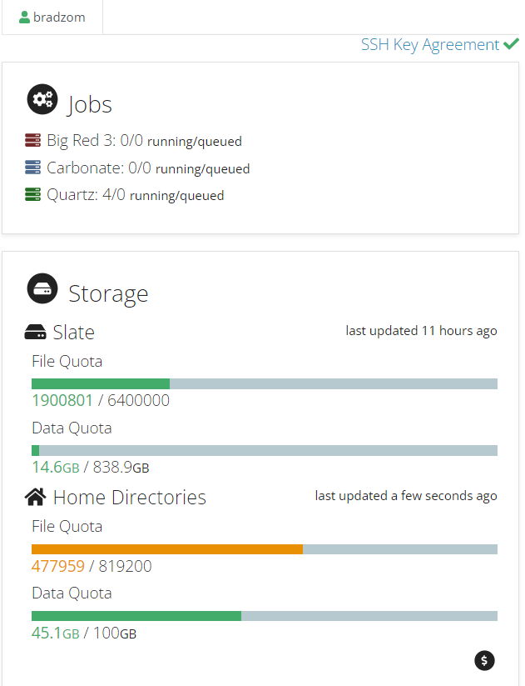
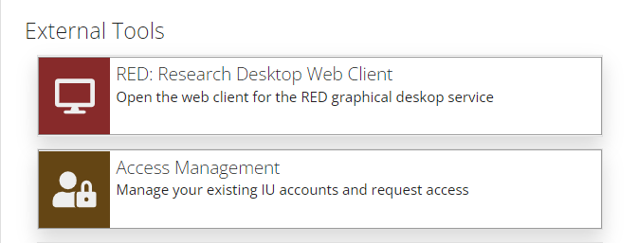
HPC everywhere https://hpceverywhere.iu.edu
Log in using IU info
Check memory, account usage stats, computer cluster availability/status

